Slide 1





SPHOORTHY ENGINEERING COLLEGE
Nadergul , Rangareddy
NEWGEN IEDC
INTELLIGENT PROCTOR

Slide 2

Introduction
The World had faced a pandemic in 2019. Covid-19 forced everyone to stay at home. Due to which all the examinations which were supposed to be held were either stopped or postponed due to the fear of the virus spreading from candidate to candidate who would be taking the exams physically. So, online exams came into practice and many exams which were very important to be held in the right time of the year for the progressive advancement of the candidate were held in online mode. Which in turn were both helpful for the candidate as well as the organizations as the student could take the exams from the comfort of their home in a safe environment without the fear of getting infected by the virus. Which indeed is very wrong and does not do justice to the students taking their exam genuinely. And the students cannot even be judged on their skill as they might have cheated in their exams.
So, we came up with a solution of an “Intelligent Proctor” which automatically monitors the candidate’s exam throughout, without the need of an actual human proctor and detects any instances of mal-practices such as the student looking away from the screen, the student using a mobile phone or any other gadget, appearance of any other person other than the student in the room, any other person helping the student by telling him the answers without appearing in the web cam etc.,
Which would make cheating in exams very difficult as we have overcomed all the ways in which the student could cheat in their examinations all this without the need of an actual proctor for monitoting every student separately throughout the exam. This in turn would help a lot and be very cost efficient for the organizations as they wouldn’t need to hire proctors to monitor every student.

Slide 3
Literature Survey
EXISTING SYSTEM
With Online exams becoming a major part in education system there has also been a rapid growth in number of cases of students cheating in their examinations. Even though there are proctors monitoring while students take their exams, students could easily manipulate the proctors by using their phones and other gadgets to cheat in the exam.
PROPOSED SYSTEM
An “Intelligent Proctor” which automatically monitors the student’s exam throughout, without the need of an actual human proctor and detects any instances of mal-practices such as the student looking away from the screen, the student using a mobile phone or any other gadget, appearance of any other person other than the student in the room, any other person helping the student by telling him the answers without appearing in the web cam.

Slide 4

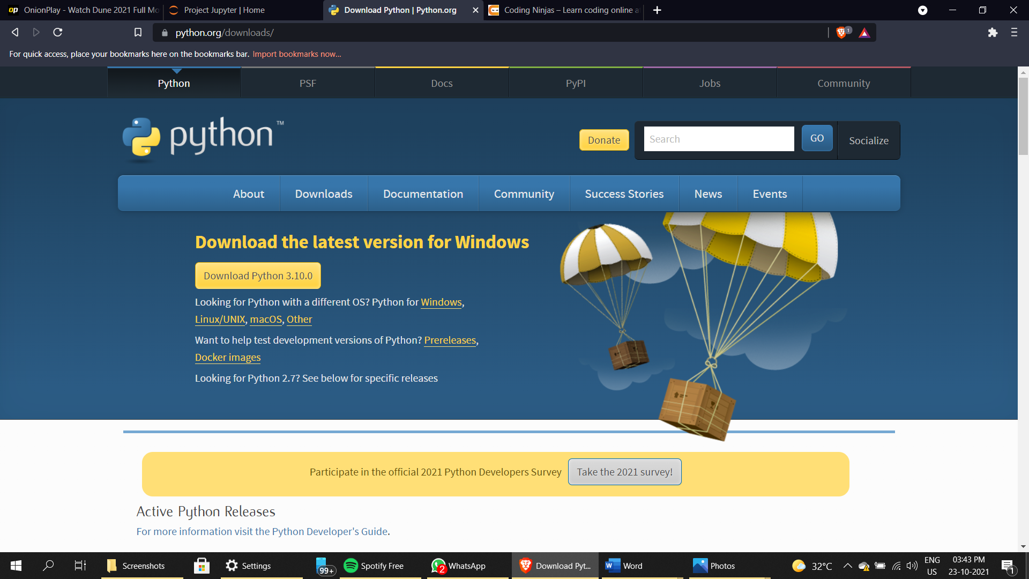
SOFTWARE ENVIRONMENTS
TECHNOLOGIES USED
Python
Python is an interpreted high-level general-purpose programming language. Its design philosophy emphasizes code readability with its use of significant indentation. Its language constructs as well as its object-oriented approach aim to help programmers write clear, logical code for small and large-scale projects.

Slide 5
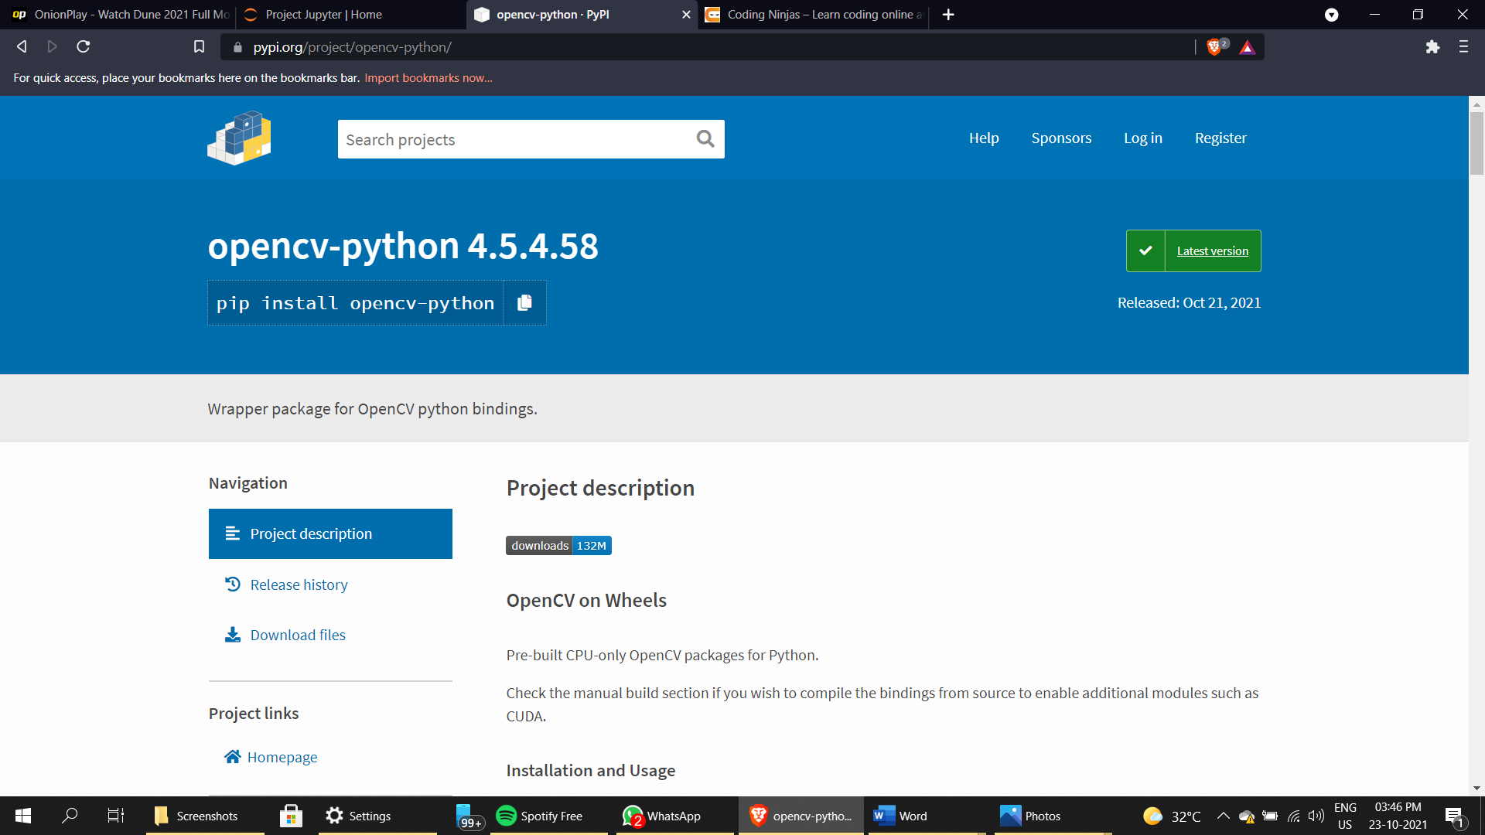
OpenCV
OpenCV is a huge open-source library for computer vision, machine learning, and image processing. OpenCV supports a wide variety of programming languages like Python, C++, Java, etc. It can process images and videos to identify objects, faces, or even the handwriting of a human.
OpenCV is used for all sorts of image and video analysis, like facial recognition and detection, license plate reading, photo editing, advanced robotic vision, optical character recognition, and a whole lot more. We will be working through many Python examples here.

Slide 6

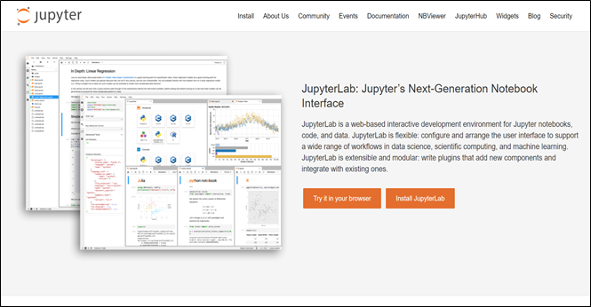
Jupyter Notebook
The Jupyter Notebook is an open-source web application that allows you to create and share documents that contain live code, equations, visualizations, and narrative text. Uses include data cleaning and transformation, numerical simulation, statistical modeling, data visualization, machine learning, and much more.

Slide 7
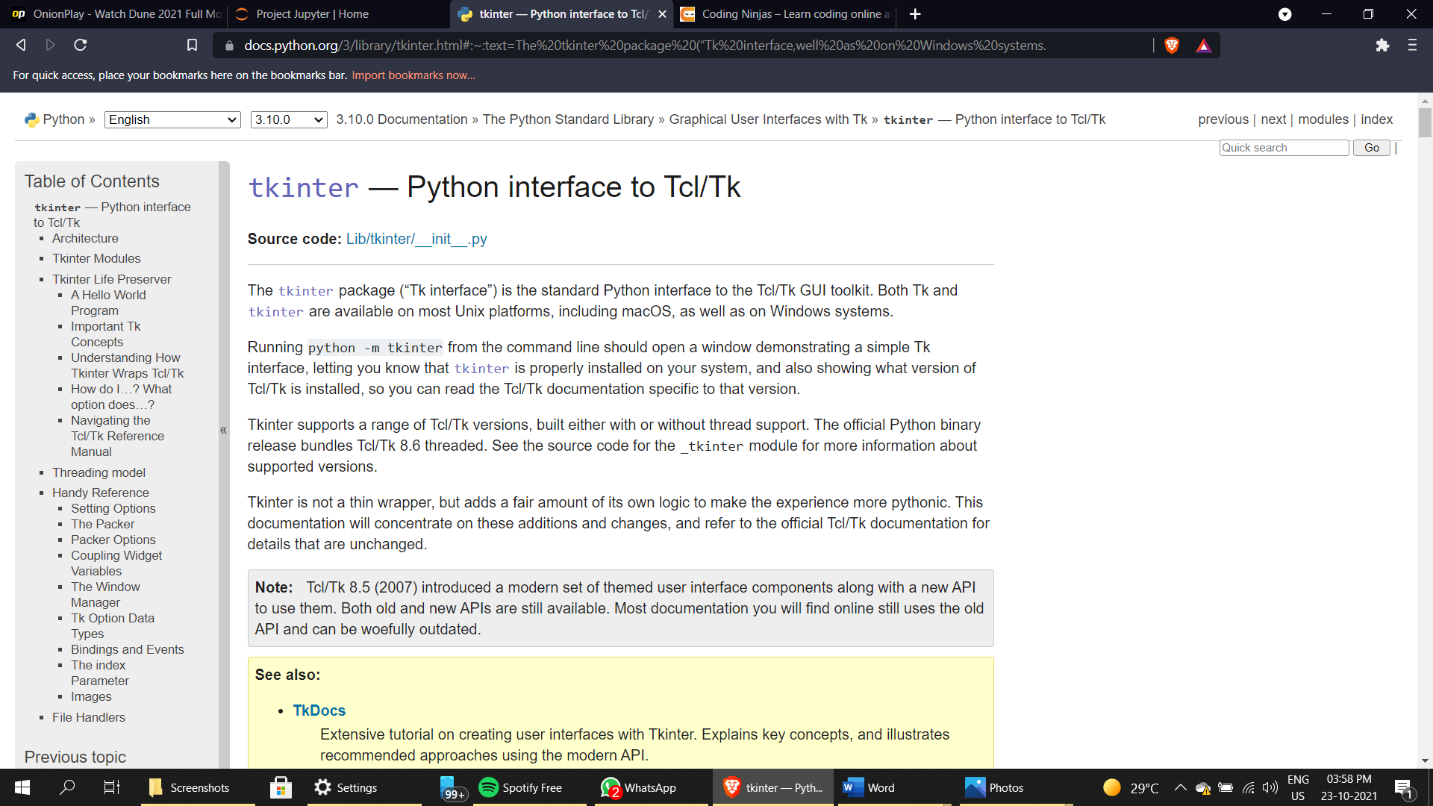
Tkinter
Tkinter is a Python binding to the Tk GUI toolkit. It is the standard Python interface to the Tk GUI toolkit and is Python's de facto standard GUI. Tkinter is included with standard GNU/Linux, Microsoft Windows and macOS installs of Python. The name Tkinter comes from Tk interface.
It is used to create Graphical User interfaces (GUIs) and is included in all standard Python Distributions. In fact, it's the only framework built into the Python standard library.

Slide 8

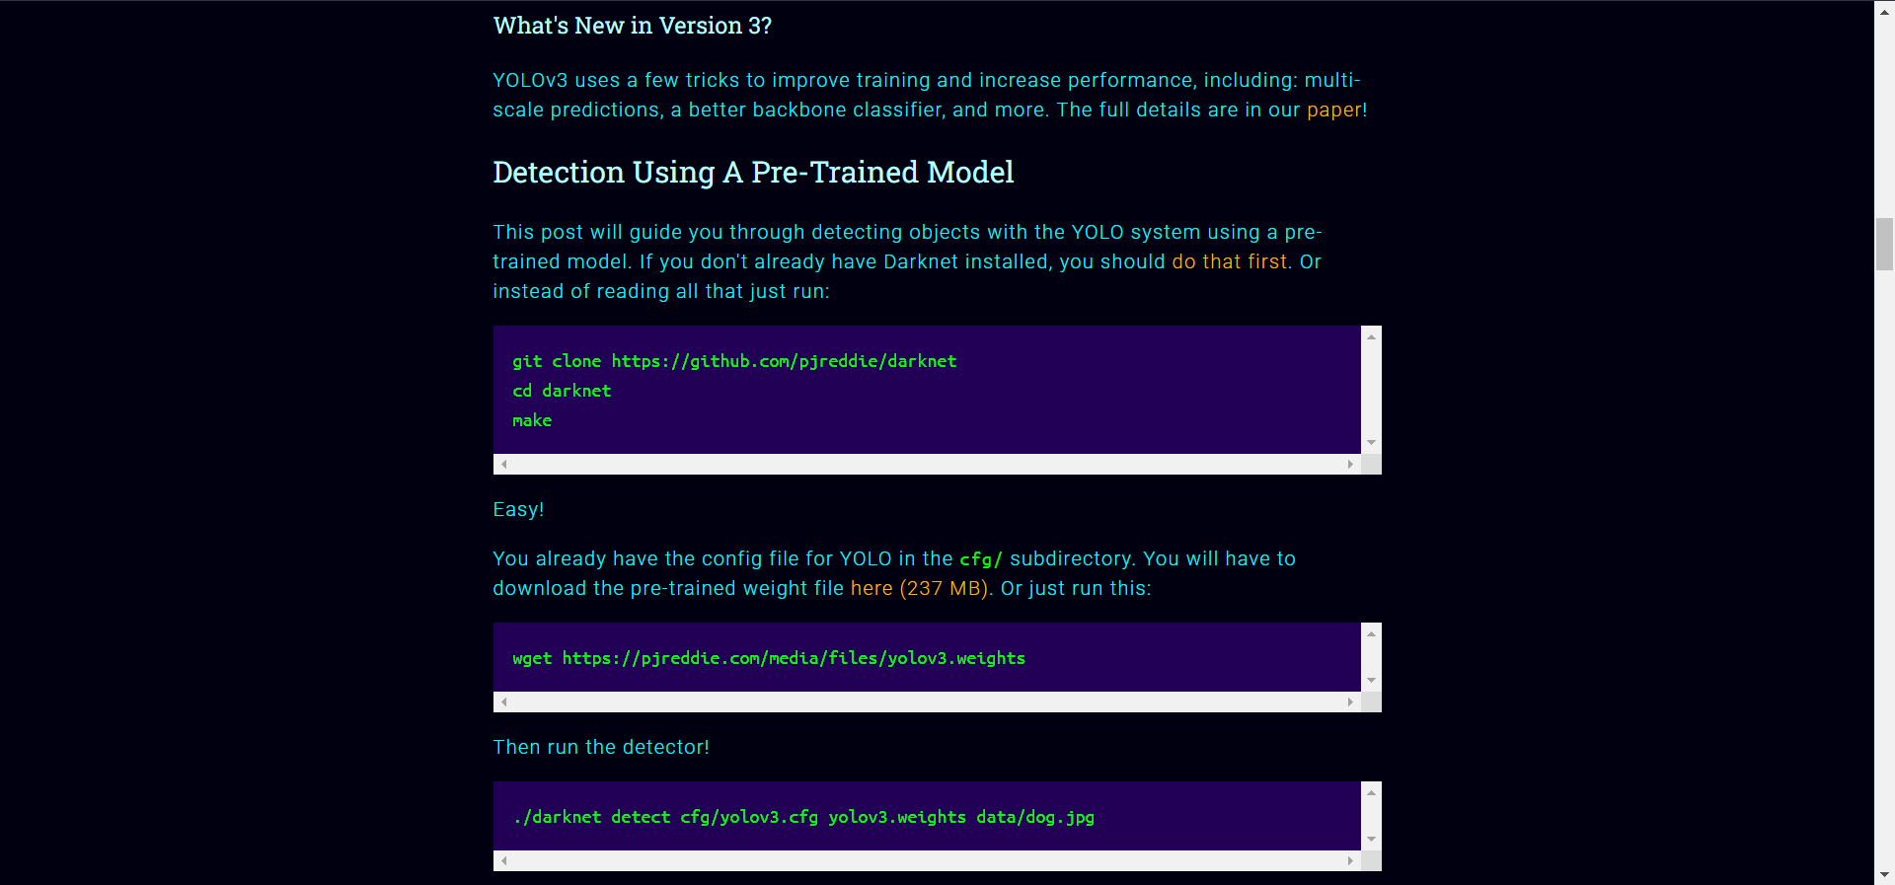
YOLO – REAL TIME OBJECT DETECTION
YOLO is an algorithm that uses neural networks to provide real-time object detection. This algorithm is popular because of its speed and accuracy. It has been used in various applications to detect traffic signals, people, parking meters, and animals.

Slide 9
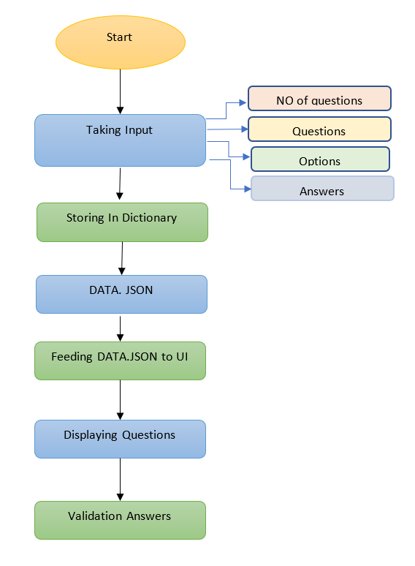
User Interface :

Slide 10
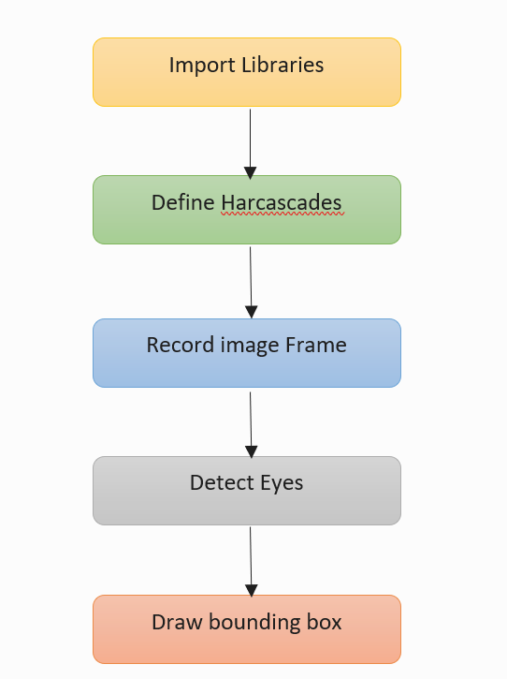
Retina Detection :

Slide 11
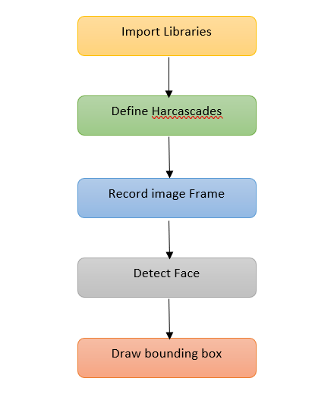
Face Detection :

Slide 12
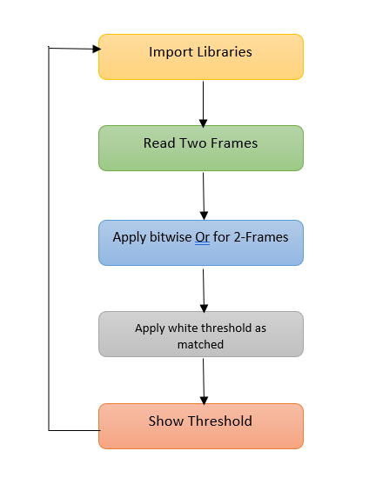
Moment detection :

Slide 13
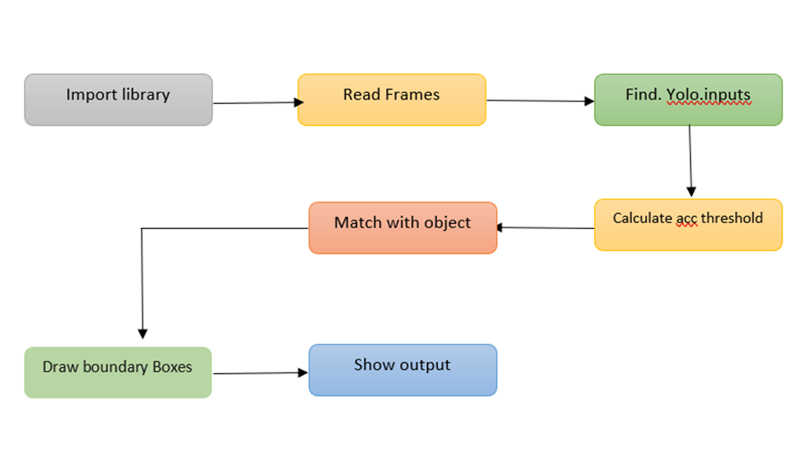
Object Detection :

Slide 14
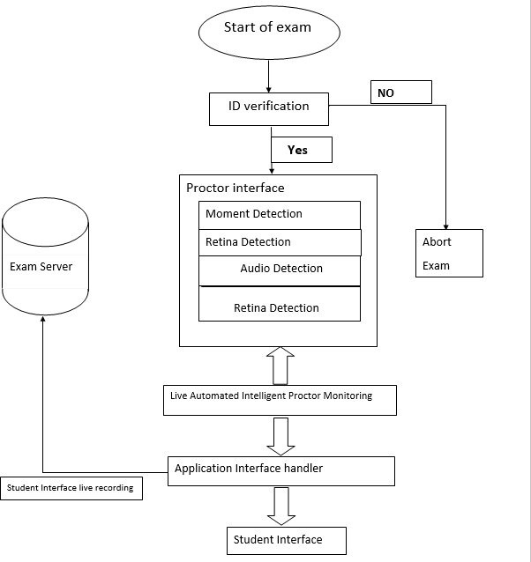
BLOCK DIAGRAM

Slide 15
INTELLIGENT PROCTOR: The Artificial Intelligence based proctoring makes an automation to prevent malpractice while conducting online examinations
Steps involved in working of the software
Student authentication
Application interface
Moment detection
Retina detection
Object detection
Audio detection

Slide 16
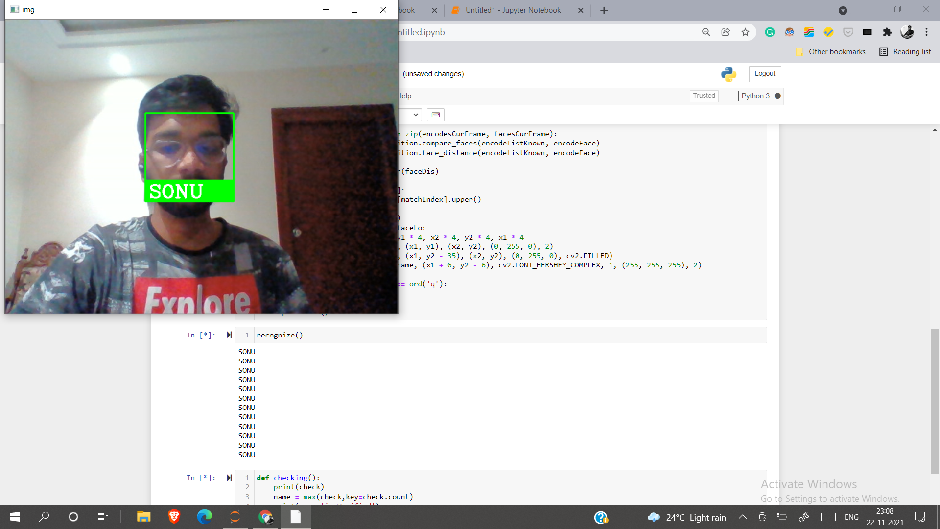
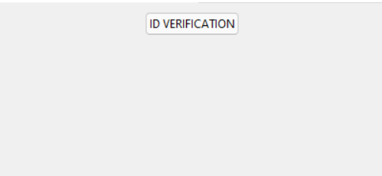
Student Authentication
The authentication is done by 2-step verification from their contact number, followed by id verification.
ID Verification:
We use facial recognition implementing
through neural networks for verifying their
identification
.

Slide 17
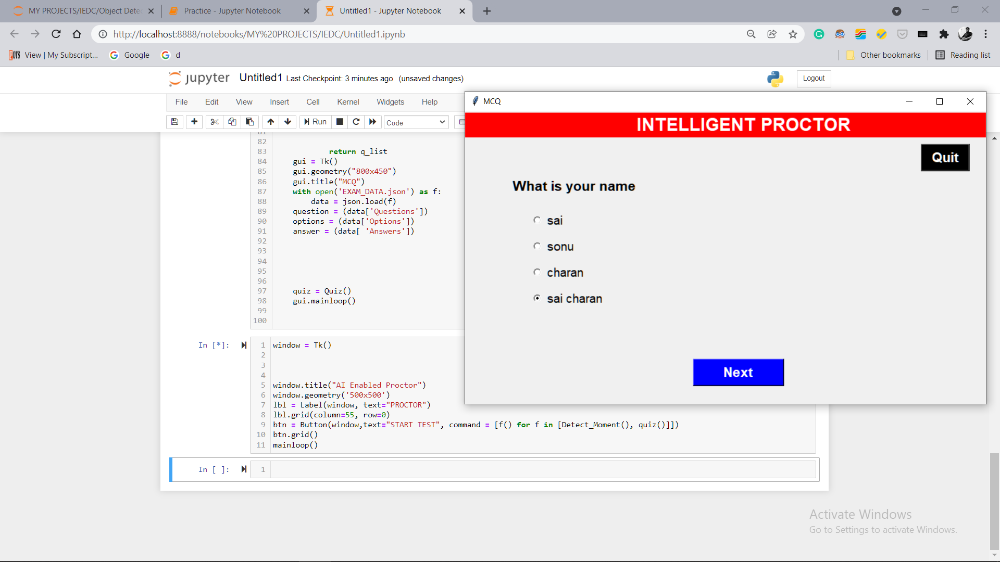
USER INTERFACE

Slide 18
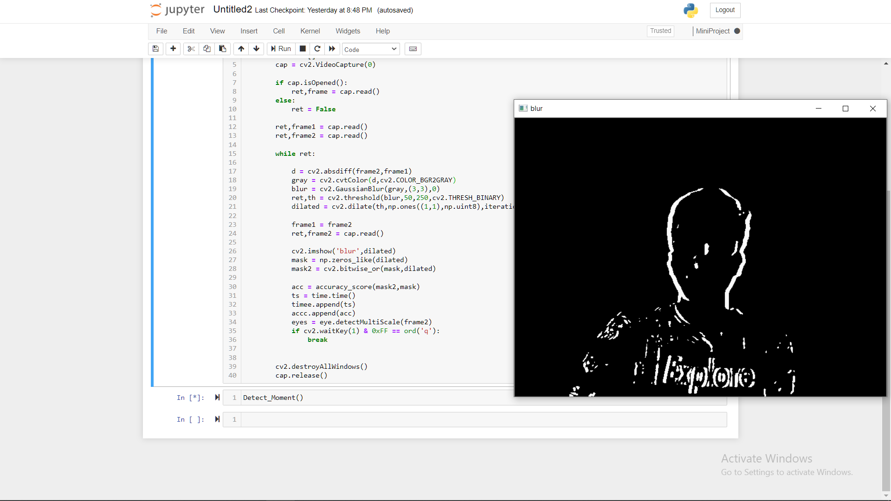
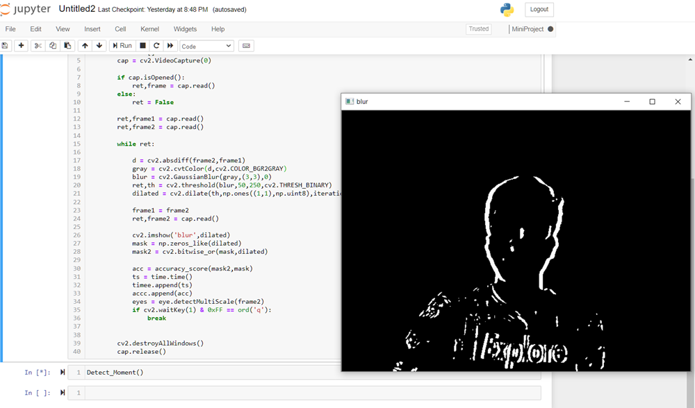
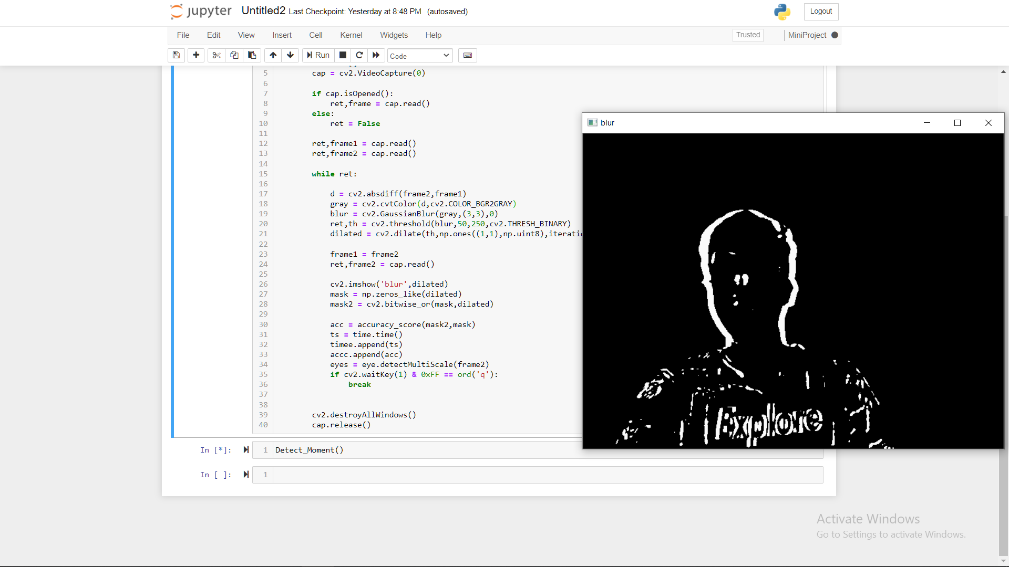
Moment Detection
When the exam starts,
Initially audio, moment detection software
will be running in backend.
If there is any moment in the frame i.e
more than threshold (60%) then
Retina detection
Object detection
will start working and prompting a warning
“YOU ARE UNDER SURVEILLANCE”

Slide 19
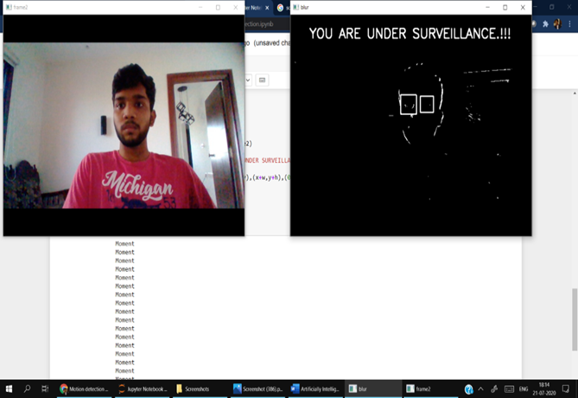
Retina detection
The retina detection will start identifying any unusual movements in the eyes i.e looking outside the screen(frame) to perform malpractice.
The screenshot demonstrates the practical implementation of artificially intelligent moment detector

Slide 20
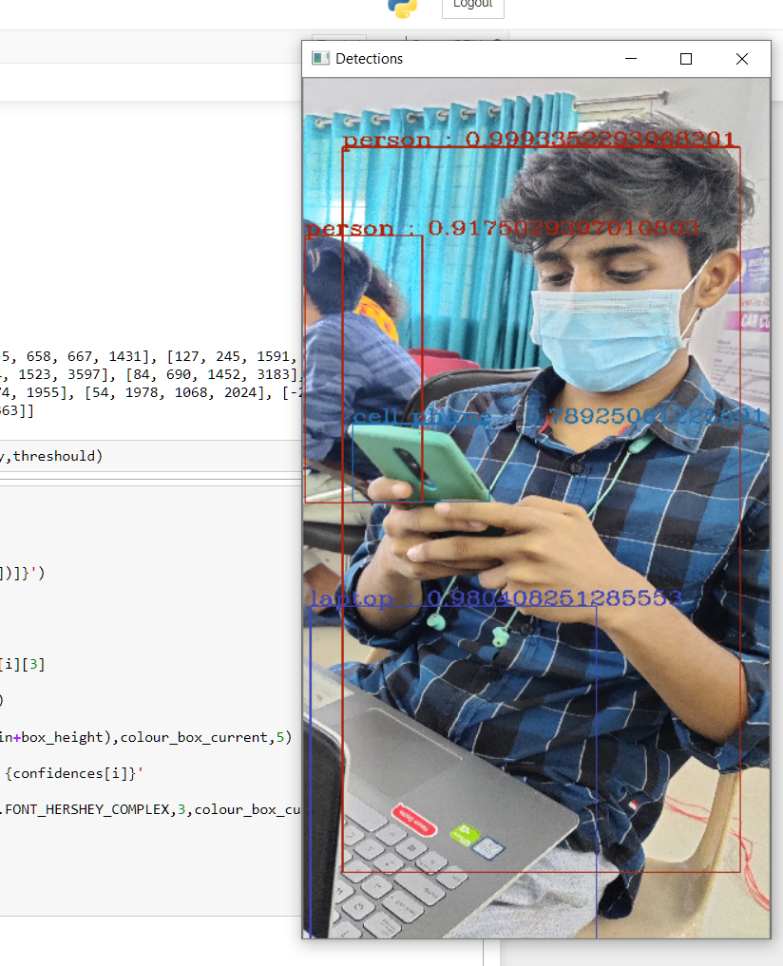
Object Detection
The object detector will perform detection for object which get in contact with student.
If the object is detected as any electronic device used for malpractice then the exam for them is terminated immediately.

Slide 21
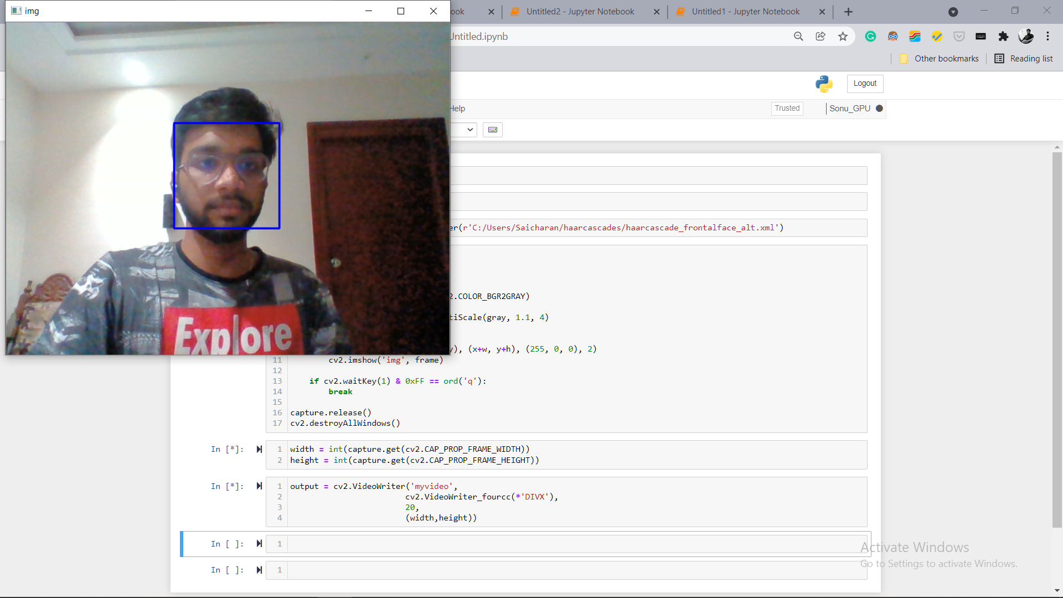
FACE DETECTION

Slide 22
System Requirements :
Hardware Requirements
8GB RAM
WEB CAM
GPU – 2GB
Software Requirements
Python should be pre-installed
Tensorflow, Keras with GPU configuration

Slide 23
FUTURE SCOPE
Code can be optimized to obtain maximum efficiency
Audio detection and recognition
A rotating mechanical part that keeps rotating can be used to build a webcam to observe student surroundings
Integration of files

Slide 24

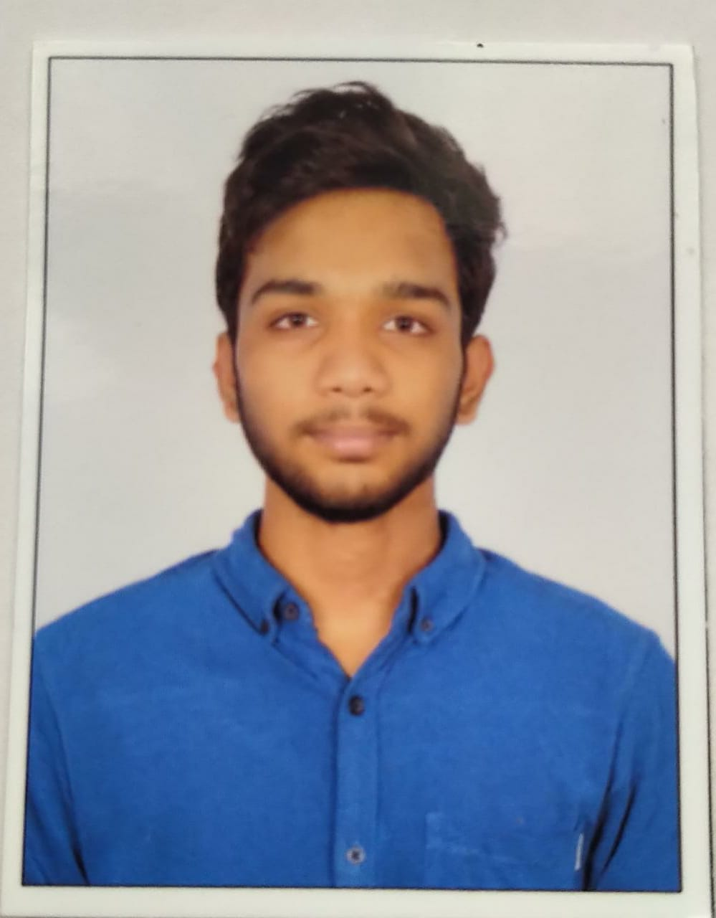

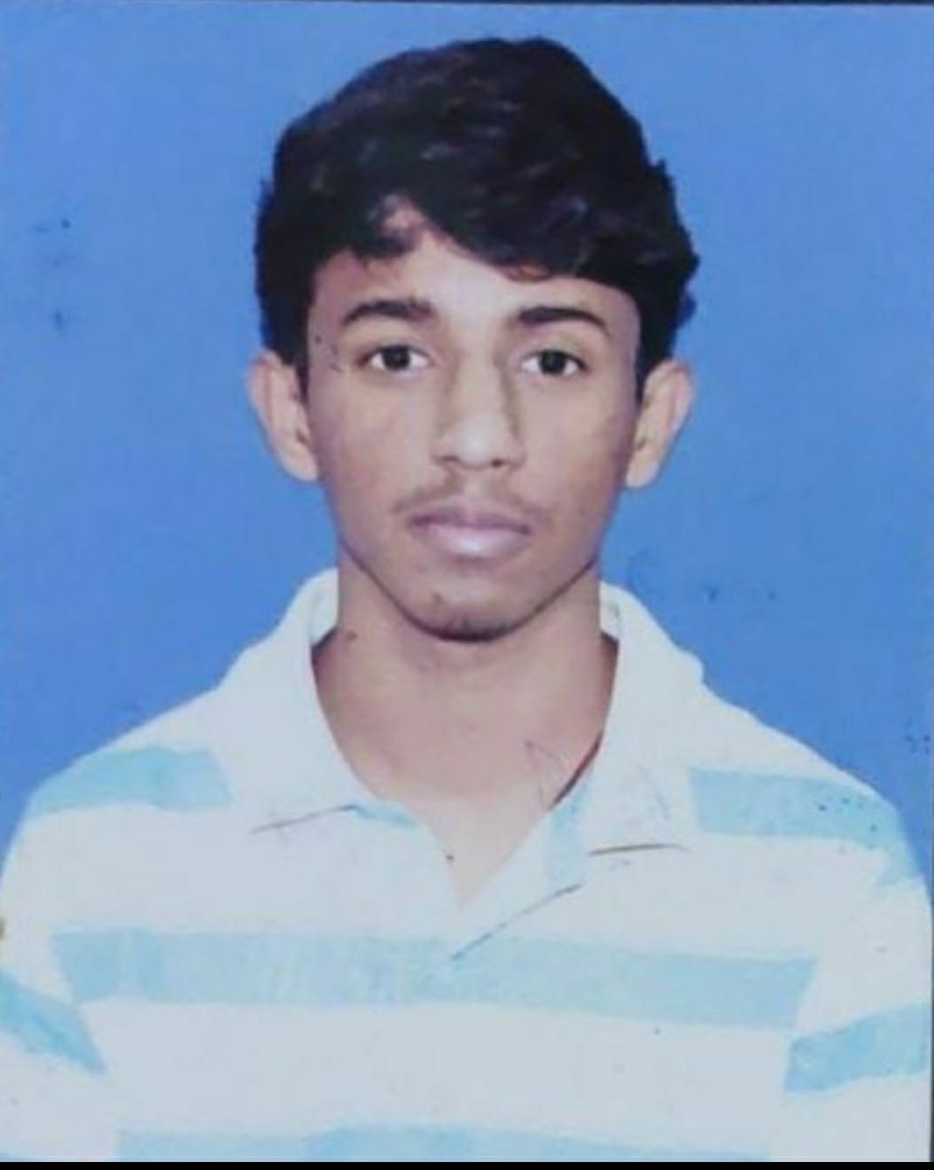
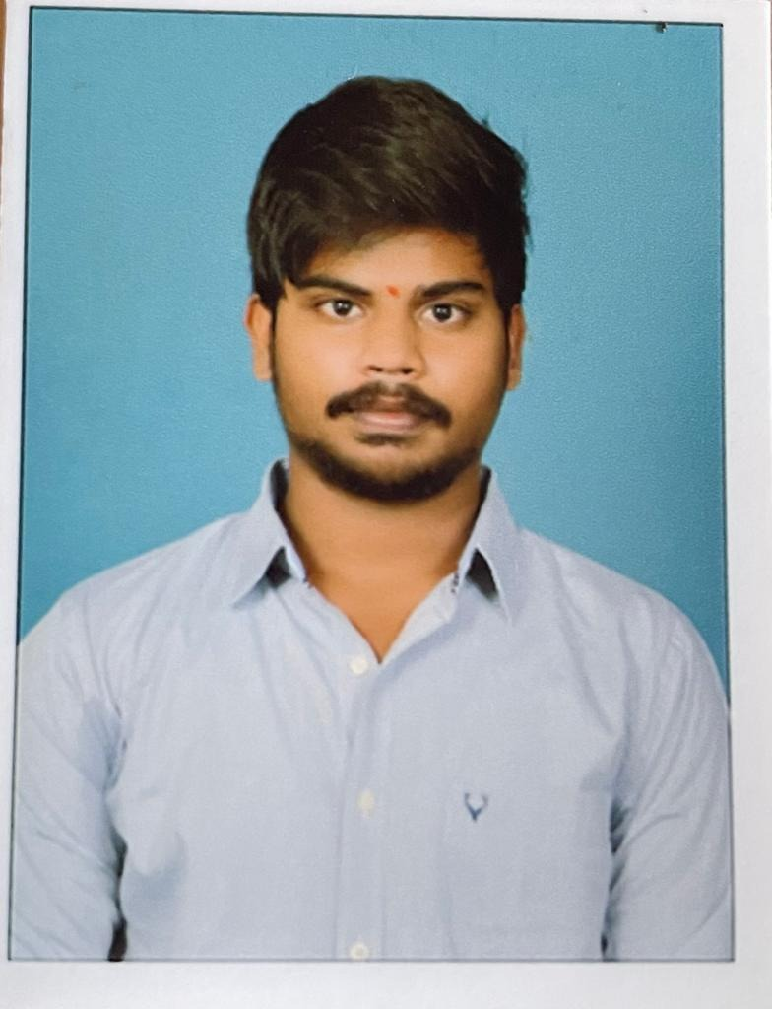
Thank you
Team Members
G.Sai charan
18N81A05N7
R.Manish
18N81A05P1
C.Rohith
18N81A05P5
B.Praneeth
18N81A05A6

